Slide 1


ESSAHFI AMINE
19-08-2022

Slide 2

Outline
Executive Summary
Introduction
Methodology
Results
Conclusion
Appendix

Slide 3
Executive Summary
Summary of methodologies
Data Collection through API
Data Collection with Web Scraping
Data Wrangling
Exploratory Data Analysis with SQL
Exploratory Data Analysis with Data Visualization
Interactive Visual Analytics with Folium
Machine Learning Prediction
Summary of all results
Exploratory Data Analysis result
Interactive analytics in screenshots
Predictive Analytics result

Slide 4
Introduction
Summary of methodologies
Data Collection through API
Data Collection with Web Scraping
Data Wrangling
Exploratory Data Analysis with SQL
Exploratory Data Analysis with Data Visualization
Interactive Visual Analytics with Folium
Machine Learning Prediction
Summary of all results
Exploratory Data Analysis result
Interactive analytics in screenshots
Predictive Analytics result

Slide 5

Section 1

Slide 6
Methodology
Executive Summary
Data collection methodology:
Data was gathered through a combination of the SpaceX API in addition to WebScraping.
Perform data wrangling
Categorical Feautures were one-hot encoded.
Perform exploratory data analysis (EDA) using visualization and SQL
Perform interactive visual analytics using Folium and Plotly Dash
Perform predictive analysis using classification models
How to build, tune, evaluate classification models

Slide 7
Data Collection
The data was collected using various methods
Using the request library , data was pulled from the SpaceX API , using GET request , which returned a JSON that was converted to a dataframe using json_normalize().
Performed the necessary cleaning ie (dealing with missing values ... etc)
additional data was provided by webscraping from the falcon 9 lauch records page on Wikipedia.
data was scraped from HTML table using beautifulsoup for the sake of being converted to a dataframe for further analysis.

Slide 8

Data Collection – SpaceX API
We used the get request to the SpaceX API to collect data, clean the requested data and did some basic data wrangling and formatting.
The link to the notebook is https://github.com/amineessahfi/IBM_Capstone_SpaceX/blob/main/Capstone_Project/Data%20Collection%20API.ipynb

Slide 9

Data Collection - Scraping
We applied web scrapping to webscrap Falcon 9 launch records with BeautifulSoup
We parsed the table and converted it into a pandas dataframe.
The link to the notebook is https://github.com/amineessahfi/IBM_Capstone_SpaceX/blob/main/Capstone_Project/Data%20Collection%20with%20Web%20Scraping.ipynb

Slide 10
Data Wrangling
We performed exploratory data analysis and determined the training labels.
We calculated the number of launches at each site, and the number and occurrence of each orbits
We created landing outcome label from outcome column and exported the results to csv.
The link to the notebook is https://github.com/amineessahfi/IBM_Capstone_SpaceX/blob/main/Capstone_Project/Data%20Wrangling.ipynb

Slide 11


EDA with Data Visualization
We investigated the data by showing the link between the flight number and the launch site, the payload and the launch site, the success rate of each orbit type, the flight number and the orbit type, and the yearly trend in launch success.
The link to the notebook is https://github.com/amineessahfi/IBM_Capstone_SpaceX/blob/main/Capstone_Project/EDA%20with%20Data%20Visualization.ipynb

Slide 12
EDA with SQL
Without leaving the jupyter notebook, we imported the SpaceX dataset into a db2 database. To gain insight from the data, we used EDA in conjunction with SQL. For example, we built queries to find out:
The names of unique launch sites in the space mission.
The total payload mass carried by boosters launched by NASA (CRS)
The average payload mass carried by booster version F9 v1.1
The total number of successful and failure mission outcomes
The failed landing outcomes in drone ship, their booster version and launch site names.
The link to the notebook is https://github.com/amineessahfi/IBM_Capstone_SpaceX/blob/main/Capstone_Project/EDA%20with%20SQL.ipynb

Slide 13
Build an Interactive Map with Folium
We marked all launch sites, and added map objects such as markers, circles, lines to mark the success or failure of launches for each site on the folium map.
We assigned the feature launch outcomes (failure or success) to class 0 and 1.i.e., 0 for failure, and 1 for success.
Using the color-labeled marker clusters, we identified which launch sites have relatively high success rate.
We calculated the distances between a launch site to its proximities. We answered some question for instance:
Are launch sites near railways, highways and coastlines.
Do launch sites keep certain distance away from cities.

Slide 14
Build a Dashboard with Plotly Dash
We built an interactive dashboard with Plotly dash
We plotted pie charts showing the total launches by a certain sites
We plotted scatter graph showing the relationship with Outcome and Payload Mass (Kg) for the different booster version.
The link to the notebook is https://github.com/amineessahfi/IBM_Capstone_SpaceX/blob/main/Capstone_Project/Plotly_Viz.py

Slide 15
Predictive Analysis (Classification)
We loaded the data using numpy and pandas, transformed the data, split our data into training and testing.
We built different machine learning models and tune different hyperparameters using GridSearchCV.
We used accuracy as the metric for our model, improved the model using feature engineering and algorithm tuning.
We found the best performing classification model.
The link to the notebook is https://github.com/amineessahfi/IBM_Capstone_SpaceX/blob/main/Capstone_Project/Machine%20Learning%20Prediction.ipynb

Slide 16
Results
Exploratory data analysis results
Interactive analytics demo in screenshots
Predictive analysis results

Slide 17

Section 2

Slide 18

Flight Number vs. Launch Site
From the plot, we found that the larger the flight amount at a launch site, the greater the success rate at a launch site.

Slide 19
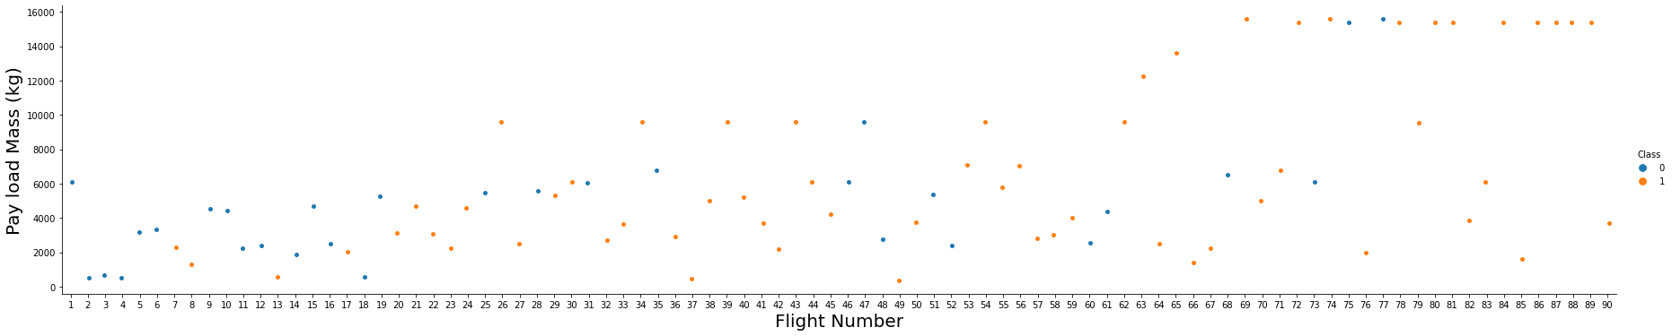
Payload vs. Launch Site

Slide 20

Success Rate vs. Orbit Type
From the plot, we can see that ES-L1, GEO, HEO, SSO, VLEO had the most success rate.

Slide 21

Flight Number vs. Orbit Type
The plot below shows the Flight Number vs. Orbit type. We observe that in the LEO orbit, success is related to the number of flights whereas in the GTO orbit, there is no relationship between flight number and the orbit.

Slide 22

Payload vs. Orbit Type
We can observe that with heavy payloads, the successful landing are more for PO, LEO and ISS orbits.

Slide 23
Launch Success Yearly Trend
From the plot, we can observe that success rate since 2013 kept on increasing till 2020.

Slide 24

All Launch Site Names
We used the key word DISTINCT to show only unique launch sites from the SpaceX data.

Slide 25

Launch Site Names Begin with 'CCA'

Slide 26

Average Payload Mass by F9 v1.1
Calculate the average payload mass carried by booster version F9 v1.1
We calculated the average payload mass carried by booster version F9 v1.1 as 2928.4

Slide 27

Total Payload Mass

Slide 28

First Successful Ground Landing Date
We observed that the dates of the first successful landing outcome on ground pad was 22nd December 2015

Slide 29

Successful Drone Ship Landing with Payload between 4000 and 6000
We used the WHERE clause to filter for boosters which have successfully landed on drone ship and applied the AND condition to determine successful landing with payload mass greater than 4000 but less than 6000

Slide 30

Total Number of Successful and Failure Mission Outcomes
We used wildcard like ‘%’ to filter for WHERE MissionOutcome was a success or a failure.

Slide 31

Boosters Carried Maximum Payload
We determined the booster that have carried the maximum payload using a subquery in the WHERE clause and the MAX() function.

Slide 32

2015 Launch Records
For the year 2015, we utilized a mix of the WHERE clause, LIKE, AND, and BETWEEN criteria to filter for unsuccessful landing outcomes in drone ships, booster versions, and launch location names.

Slide 33

Rank Landing Outcomes Between 2010-06-04 and 2017-03-20
Rank the count of landing outcomes
(such as Failure (drone ship) or Success (ground pad))
between the date 2010-06-04 and 2017-03-20, in descending order
We selected Landing outcomes and the COUNT of landing outcomes from the data and used the WHERE clause to filter for landing outcomes BETWEEN 2010-06-04 to 2010-03-20.
We applied the GROUP BY clause to group the landing outcomes and the ORDER BY clause to order the grouped landing outcome in descending order.

Slide 34

Section 3

Slide 35
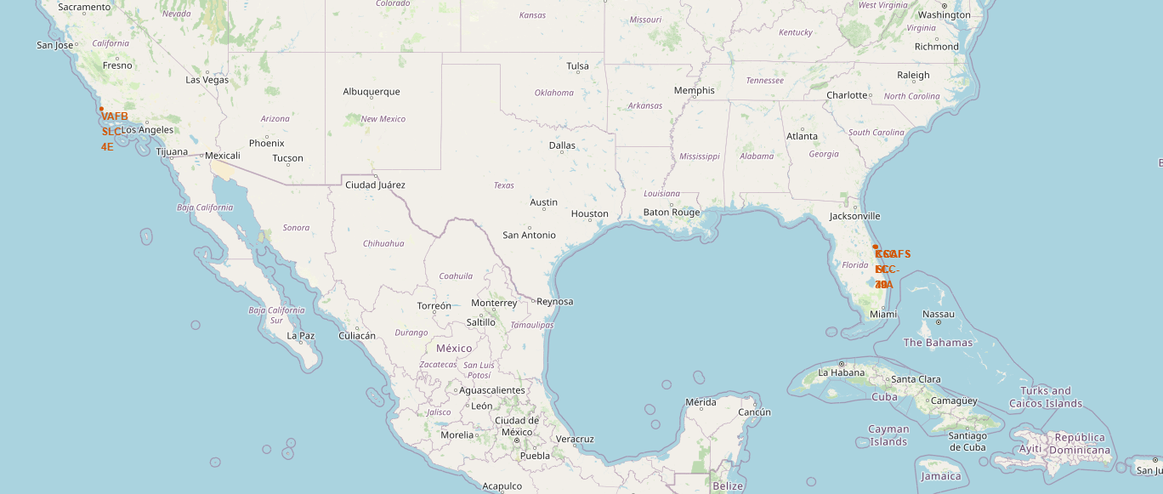
US-LanchSites Map Markers
SpaceX Launch Sites are Situated in FL,CA ,UnitedStates

Slide 36
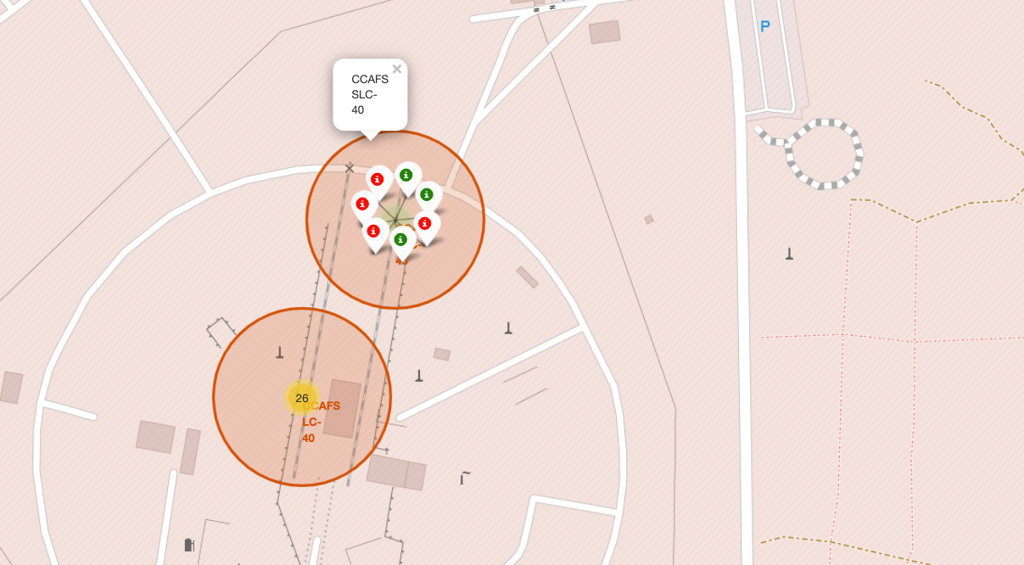
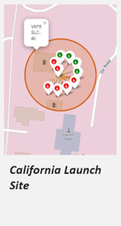
Launch Sites
Florida Launch Site
Green Marker: Mission Success
Red Marker: Mission Failure

Slide 37

Launch Site-landmarks Distance

Slide 38

Section 4

Slide 39
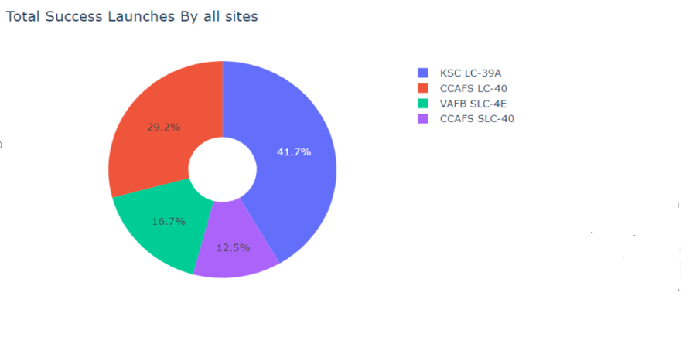
Pie chart showing the success percentage achieved by each launch site
Most Succesful Launches Happened in KSC LC-39A Site

Slide 40
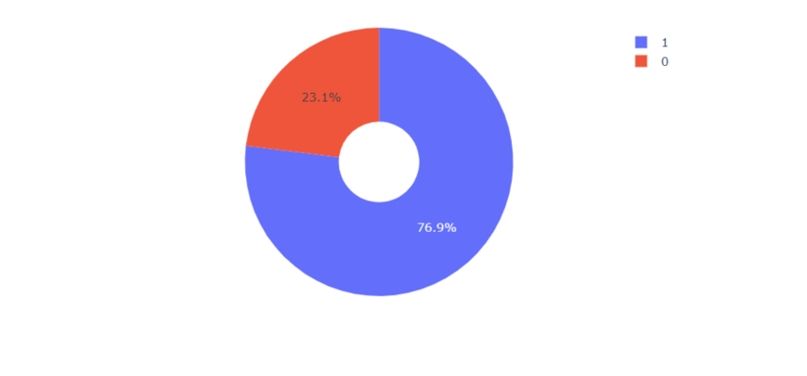
KSC LC-39A Site Success/Failure Rate
KSC LC-39A Site Achieved a 76.9%/23.1% Sucess/Failure Rate

Slide 41
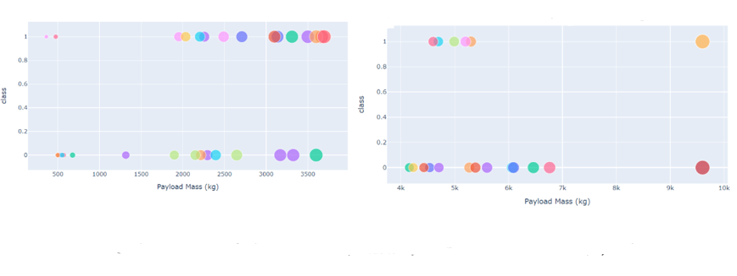
Scatter plot of Payload vs Launch Outcome for all sites, with different payload selected in the range slider

Slide 42

Section 5

Slide 43

Classification Accuracy
The Best Model Accuracy Was Obtained Through DecisionTree With A Score of ~0.87

Slide 44

Confusion Matrix
The confusion matrix for the decision tree classifier demonstrates that the classifier can differentiate between the various classes. The main issue is false positives. i.e., the classifier considers an unsuccessful landing to be a successful landing.

Slide 45
Conclusions
We can draw the following conclusion:
A launch site's success rate increases with the size of the flight quantity.
From 2013 through 2020, the success rate of new product launches is expected to rise.
The most successful orbits were ES-L1, GEO, HEO, SSO, and VLEO.
The launch of KSC LC-39A was the most successful of any facility.
The best machine learning algorithm for this job is the Decision tree classifier.

Slide 46


